Slide 1
CSCI 558L Lecture 8: Details of IP
Internetworking and Distributed Systems Laboratory
Young Cho
Department of Computer Science
University of Southern California
Slides adopted from Rice

Slide 2
IPv4 (RFC 791): IP Version
Ver
Differentiated service
Ver
IHL
IHL
Type of service
Total length
Total length
Identification (frag id)
Identification
Flags (frag)
Flags
Fragment offset
Fragment offset
Time to live
Time to live
(next) Protocol
Protocol
Header checksum
Header checksum
Source address
Source address
Destination address
Destination address
Option + Padding
Option + Padding
IPv4 or IPv6
Other options

Slide 3
Header Length
Ver
Differentiated service
Ver
IHL
IHL
Type of service
Total length
Total length
Identification (frag id)
Identification
Flags (frag)
Flags
Fragment offset
Fragment offset
Time to live
Time to live
(next) Protocol
Protocol
Header checksum
Header checksum
Source address
Source address
Destination address
Destination address
Option + Padding
Option + Padding
Number of 32 bit words in the header
Calculate based on the used options

Slide 4
Differentiated Services
Ver
Differentiated services
Ver
IHL
IHL
Type of service
Total length
Total length
Identification (frag id)
Identification
Flags (frag)
Flags
Fragment offset
Fragment offset
Time to live
Time to live
(next) Protocol
Protocol
Header checksum
Header checksum
Source address
Source address
Destination address
Destination address
Option + Padding
Option + Padding
Type of Service field before
Renamed to Differentiated Services
Six bits of the DS field are used to define how packets are queued at network nodes
Quality of Service guarentees

Slide 5
Total Length
Ver
Differentiated service
Ver
IHL
IHL
Type of service
Total length
Total length
Identification (frag id)
Identification
Flags (frag)
Flags
Fragment offset
Fragment offset
Time to live
Time to live
(next) Protocol
Protocol
Header checksum
Header checksum
Source address
Source address
Destination address
Destination address
Option + Padding
Option + Padding
Number of total bytes of IP Packet
Header plus the Payload

Slide 6
Identification
Ver
Differentiated service
Ver
IHL
IHL
Type of service
Total length
Total length
Identification (frag id)
Identification
Flags (frag)
Flags
Fragment offset
Fragment offset
Time to live
Time to live
(next) Protocol
Protocol
Header checksum
Header checksum
Source address
Source address
Destination address
Destination address
Option + Padding
Option + Padding
Unique for each source/destination/protocol combination while the datagram is in-flight
Can be used to determine which datagram a fragment came from

Slide 7
Flags
Ver
Differentiated service
Ver
IHL
IHL
Type of service
Total length
Total length
Identification (frag id)
Identification
Flags (frag)
Flags
Fragment offset
Fragment offset
Time to live
Time to live
(next) Protocol
Protocol
Header checksum
Header checksum
Source address
Source address
Destination address
Destination address
Option + Padding
Option + Padding
3 bits: Reserved/DF/MF
DF: Don’t fragment
MF: More fragments follow this packet

Slide 8
Fragment Offset
Ver
Differentiated service
Ver
IHL
IHL
Type of service
Total length
Total length
Identification (frag id)
Identification
Flags (frag)
Flags
Fragment offset
Fragment offset
Time to live
Time to live
(next) Protocol
Protocol
Header checksum
Header checksum
Source address
Source address
Destination address
Destination address
Option + Padding
Option + Padding
Offset of fragment in original datagram
13 bits wide, but measures units of 8 bytes each
2¹³ x 8 = 64k (so we can fragment the entire packet)
What is the smallest fragment size?

Slide 9
Time-to-Live
Ver
Differentiated service
Ver
IHL
IHL
Type of service
Total length
Total length
Identification (frag id)
Identification
Flags (frag)
Flags
Fragment offset
Fragment offset
Time to live
Time to live
(next) Protocol
Protocol
Header checksum
Header checksum
Source address
Source address
Destination address
Destination address
Option + Padding
Option + Padding
“Hop count” – decrement each hop
Discard datagrams with 0 TTL

Slide 10
Protocol
Ver
Differentiated service
Ver
IHL
IHL
Type of service
Total length
Total length
Identification (frag id)
Identification
Flags (frag)
Flags
Fragment offset
Fragment offset
Time to live
Time to live
(next) Protocol
Protocol
Header checksum
Header checksum
Source address
Source address
Destination address
Destination address
Option + Padding
Option + Padding
Protocol encapsulated in this IP datagram
1 = ICMP,
6 = TCP
17 = UDP
etc…

Slide 11
Header Checksum
Ver
Differentiated service
Ver
IHL
IHL
Type of service
Total length
Total length
Identification (frag id)
Identification
Flags (frag)
Flags
Fragment offset
Fragment offset
Time to live
Time to live
(next) Protocol
Protocol
Header checksum
Header checksum
Source address
Source address
Destination address
Destination address
Option + Padding
Option + Padding
A checksum of the header data
Checking for integrity of the header

Slide 12
IP Addresses
Ver
Differentiated service
Ver
IHL
IHL
Type of service
Total length
Total length
Identification (frag id)
Identification
Flags (frag)
Flags
Fragment offset
Fragment offset
Time to live
Time to live
(next) Protocol
Protocol
Header checksum
Header checksum
Source address
Source address
Destination address
Destination address
Option + Padding
Option + Padding
Source and Destination IP Address
32 bit wide

Slide 13
Options and Padding
Ver
Differentiated service
Ver
IHL
IHL
Type of service
Total length
Total length
Identification (frag id)
Identification
Flags (frag)
Flags
Fragment offset
Fragment offset
Time to live
Time to live
(next) Protocol
Protocol
Header checksum
Header checksum
Source address
Source address
Destination address
Destination address
Option + Padding
Option + Padding
Additional route information, timestamps, experimental information, etc.
Padding bytes to make 8 bytes alignment

Slide 14
IPv6 Header
Ver
Differentiated service
Flow Label
Ver
Total length
Payload Length
Hop Limit
Identification
Next Header
Flags
Source address
Source address
Destination address
Destination address
Flow Label - specifies special router handling
Payload Length – does not include header length (0 = hop-by-hop Jumbo packet)
Next Header – Encapsulated Protocol
Hop Limit – Replaces TTL
IP addresses – 128 bits: 2¹²⁸ address space
Options are implemented as additional extension header
Refer to RFC2460

Slide 15
Why not just Ethernet
Most computer systems use Ethernet
Ethernet provides facilities to
Locate computers
Forward packets directly
Prevent loops
…
Drawbacks of Ethernet?

Slide 16
Ethernet Drawbacks
Locating computers
Do we really want to broadcast across the Internet?
Preventing loops
Do we really want to rebuild an Internet-wide spanning tree whenever the topology changes?
Do we really want packets to live forever if loops remain?
Unreachable computers
What happens if the destination is unreachable?
I.e., it doesn’t exist, is turned off, is broken, …

Slide 17
Reasons to use Link Layer
“Most” is not “All”
Not all networks are Ethernet
Why limit choice, innovation, etc. at the link level?
Link layer
What is the best way to move local traffic (single hop)?
Old/new network, wired/wireless network, …
Different links can use different networks!
Network layer
What is the best to handle multi-hop communication?
Addressing
Unreliable delivery mechanisms (routing)

Slide 18
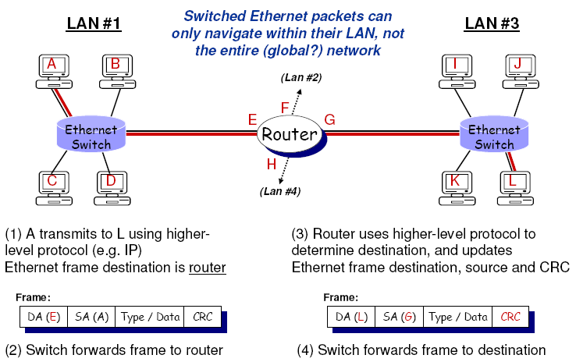
Routing between LANs

Slide 19
The Internet Protocol
Datagram
Each packet is individually routed
Packets may be fragmented or duplicated
Due to underlying networks
Connectionless
No guarantee of delivery in sequence
Unreliable
No guarantee of delivery
No guarantee of integrity of data
Best effort
Only drop packets when necessary
No time guarantee for delivery

Slide 20
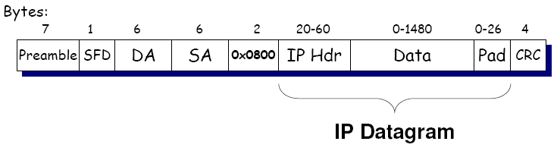
IP and Ethernet
IP datagrams can be encapsulated in Ethernet frames

Slide 21
Understanding IP
Datagram lifetimes
Time-to-live
Handling disparate link layers
Fragmentation
IP integrity
Header checksum
What do datagrams look like?
Header format
Addressing

Slide 22
Time-to-Live
Sender sets a TTL value for each datagram
Each router decrements the TTL
When the TTL reaches 0
The router drops the datagram
The router sends an ICMP error to the sender
Effectively a “maximum hop count”
Why is this useful/interesting/necessary?
Tool: Traceroute
Tool to find the route IP packets take through the Internet
Send packets with successively increasing TTL values
See what routers respond with ICMP “Time Exceeded” errors

Slide 23
Using Traceroute
The first three packets sent have a time-to-live (TTL) value of one
The next three packets have a TTL value of 2, and so on
The router decrements the TTL value, and forwards the packet
When TTL of one reaches a router, it discards the packet
Then the host sends an ICMP time exceeded packet to the sender
wee.isi.edu:$ traceroute www.usc.edu
traceroute to www.usc.edu (128.125.253.146), 30 hops max, 60 byte packets
1 router.postel.org (128.9.112.7) 0.655 ms 1.081 ms 1.512 ms
2 198.32.16.30 (198.32.16.30) 2.399 ms 2.468 ms 2.517 ms
3 * * *
4 v249-gw-8.usc.edu (68.181.194.73) 1.234 ms 1.257 ms 1.304 ms
5 cwis.usc.edu (128.125.253.146) 0.841 ms 0.821 ms 0.823 ms
wee.isi.edu:$

Slide 24
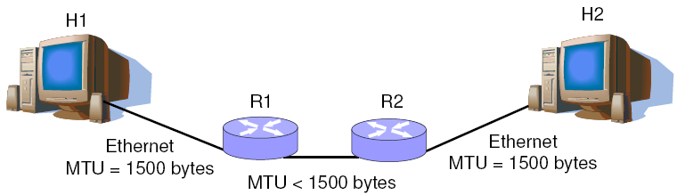
The Maximum Transmission Unit
Not all networks have the same max transmission unit (MTU)
IP can be larger (64KB) than the Ethernet MTU (1500 bytes)
How does IP datagrams still get delivered?

Slide 25
Fragmentation
Routers fragment IP datagrams
Break datagram into MTU-sized datagrams
Set “MF” (more fragments) flag as necessary
Set fragment offset field appropriately
May need to refragment fragmented datagrams!
Datagrams are reassembled by the receiver
Routers do not reassemble fragments
Once fragmented, a datagram remains fragmented

Slide 26
Routing Fragments
Fragments are routed independently
Fragment could be lost or duplicated
Receiver must reassemble fragments
May arrive out of order
May not all arrive - must drop entire datagram
Seems broken. Can we fix it?

Slide 27
Avoiding Fragmentation
Purpose: reduce processing overhead
Source can prevent frag with “DF” flag
Routers send “ICMP” (more later) error if too large
Hosts trys to avoid fragmentation
Use “path MTU Discovery” to find the smallest MTU
Or send successively smaller datagrams until no frag
Try it yourself on DETER nodes
“traceroute –F host size”

Slide 28
IP Checksum
Detect corruption in the IP header
Payload is not covered
Not enough information to correct errors
16-bit one’s complement checksum
Set checksum field in header to zero
One’s complement sum of all 16-bit values (use end-around carry) and negate (one’s complement) result
Why is it there?

Slide 29
Calculating the IP Checksum
unsigned short cksum(uint16 *ip, int len) {
uint32 sum = 0;
while (len > 1) {
sum += *ip++;
if(sum & 0x80000000) /* if high order bit set, fold */
sum = (sum & 0xFFFF) + (sum >> 16);
len -= 2;
}
if (len) /* take care of left over byte */
sum += (uint16) *(uint8 *)ip;
while (sum >> 16)
sum = (sum & 0xFFFF) + (sum >> 16);
return ~sum;
}

Slide 30
Verifying the IP Checksum
Two methods
Recalculate IP checksum (with 0 in checksum header field) and compare to checksum in header
One’s complement sum of entire IP header (including checksum) and compare to -0 (0xffff)
Why does the second technique work?
Read RFC1071

Slide 31
Incremental IP Checksum Update
Routers must modify the TTL
Checksum must be recomputed
Recompute the checksum?
From scratch?
Incremental update?
Incremental Update
Read RFC1624

Slide 32
Next
Next Lecture
IP Addressing and ICMP
Laboratory
Fast and Reliable File Transfer Tournament
Use the script
The Tournament Sept 24
Semi-final/Final on Sept 25 in class
Final Source Code due Sept 25 at 11:55pm
Reading Assignment
White, L. et al, "An Integrated Experimental Environment for Distributed Systems and Networks", OSDI 2002, December 2002.

